Slide 1
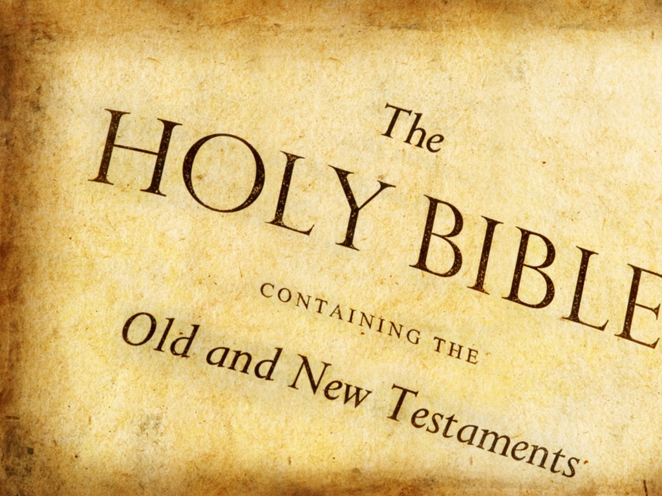
SCRIPTURE

Slide 2
SCRIPTURE
A talk and discussion
Fr Barnabas
Lent 2018

Slide 3
Hymn - Ancient Words

Slide 4
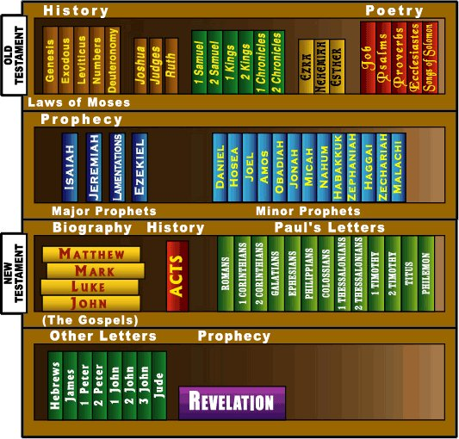

Slide 5
Apocryphal books
The Catholic Bible has additional books that do not appear in all versions of the Bible used by other denominations. They are sometimes referred to as the Apocryphal books, from the Greek word for hidden.
The books are: Tobit, Judith, Wisdom, Sirach, Baruch, and 1 and 2 Maccabees.
This difference occurred because they were writings not used by the Jewish Christians but were in common use by the early Greek speaking Christians.
Their inclusion in the Catholic Bible we know was confirmed by the Second Council of Trent in 1546 who considered them inspired by God. (This is something which some other Christians denominations disagree with, which is why these books do not appear in their version of the Bible).

Slide 6
The main phases, time line and books of the Bible that tell the salvation story:
Early World Creation to 2000 BC Genesis 1-11 | Patri- Archs 2000 -1700 BC Genesis 12- 50 | Egypt & Exodus 1700 - 1280 BC Exodus | Desert Wanderings 1280 – 1240 BC Numbers | Conquest & Judges 1240 – 1050 BC Joshua, Judges | Royal Kingdom 1050 – 930 BC 1 & 11 Samuel | Divided Kingdom 930 – 722 BC | Exile 722 – 540 BC | Return 538 – 167 BC Ezra, Nehemiah | Macabean Revolt 167 – 0 BC 1 Maccabees | Messianic Fulfillment 0 – 33 AD Luke | The Church 33 AD Acts
1 Kings 11 Kings

Slide 8
The Covenant Story
In the context of the Bible, a covenant is not a contract or mutual agreement between God and man, but an unsought gift of God to man, a creative act of God’s love. (“New Covenant” by Joseph Ratzinger )
Gods Covenants with Mankind
Adam
Noah
Abraham
Moses
David
Christ

Slide 9
Covenantal Structure of Salvation History
1. Three fold promise to Abraham:
ABRAHAM
Gen. 12: 1-3
2. Three fold promise upgraded to Covenants:
1. Land Promise Genesis 15
2. Kingdom Promise Genesis 17
3. Promise of Worldwide Blessing
Genesis 22
Moses
Mosaic Covenant – Ex 24
Deuteronomic Covenant (with Moses) – Deut 29
David
Davidic Covenant
2 Sam 7
Jesus
New Covenant in Jesus Christ
Mark 14
3. Three Covenants fulfilled in Moses, David and Jesus:
Jesus
(Mk. 14)
David
(11 Sam. 7)
Moses
(Ex. 24 / Deut. 29)
Abraham
(Gen. 15,17,22)
Covenant mediator:
Noah
(Gen. 9)
Adam
(Gen. 1-3)
Family
form:
One Holy
Couple
One Holy
Family
One Holy
Tribe
One Holy
Nation
One Holy
Kingdom
One Holy Catholic and Apostolic Church

Slide 10
Covenantal Structure of Salvation History
1. Three fold promise to Abraham:
ABRAHAM
Gen. 12: 1-3
2. Three fold promise upgraded to Covenants:
1. Land Promise Genesis 15
2. Kingdom Promise Genesis 17
3. Promise of Worldwide Blessing
Genesis 22
Moses
Mosaic Covenant – Ex 24
Deuteronomic Covenant (with Moses) – Deut 29
David
Davidic Covenant
2 Sam 7
Jesus
New Covenant in Jesus Christ
Mark 14
3. Three Covenants fulfilled in Moses, David and Jesus:
Jesus
(Mk. 14)
David
(11 Sam. 7)
Moses
(Ex. 24 / Deut. 29)
Abraham
(Gen. 15,17,22)
Covenant mediator:
Noah
(Gen. 9)
Adam
(Gen. 1-3)
Family
form:
One Holy
Couple
One Holy
Family
One Holy
Tribe
One Holy
Nation
One Holy
Kingdom
One Holy Catholic and Apostolic Church

Slide 11
The Old Testament Psalms
There is a Psalm for every situation; Psalms of Praise and Thanksgiving, Psalms for forgiveness, Psalms for times of sickness, Psalms for times of worry. They are a wonderful source of inspiration and comfort.
The numbering of the Psalms can be confusing as they often appear to have two numbers. E.g. what we know as Psalm 23 “The Lord is my Shepherd” appears in other Bibles as Psalm 22.
The reason this occurs is because the Psalms were the hymn book of the Jewish temple. In the original Hebrew version a Psalm that was one song was split into separate Psalms in the Greek translation which is why Psalm 23 might be listed as Psalm 23 (22)

Slide 12
Final prayer
Father in the opening hymn we sang the words, “Ancient words ever true, changing me and changing you”. As the Holy Spirit inspired the original writers of scripture let the Holy Spirit inspire each of us, give us a greater love for and make us more familiar with your Word. Amen

